Slide 1

Cryptocurrency Price Prediction
Linta Mariya Joy
MSc cs da
msccs216

Slide 2

Introduction
A cryptocurrency, crypto-currency, or crypto
Digital Money
Work as medium of exchange through computer network
Not reliant on any central authority, to uphold or maintain it.
Types of cryptocurrencies: Bitcoin, Ethereum, Tether etc.
Ethereum is second to Bitcoin
It is Time series analysis
Ethereum Price Prediction using Prophet Model and Arima Model

Slide 3
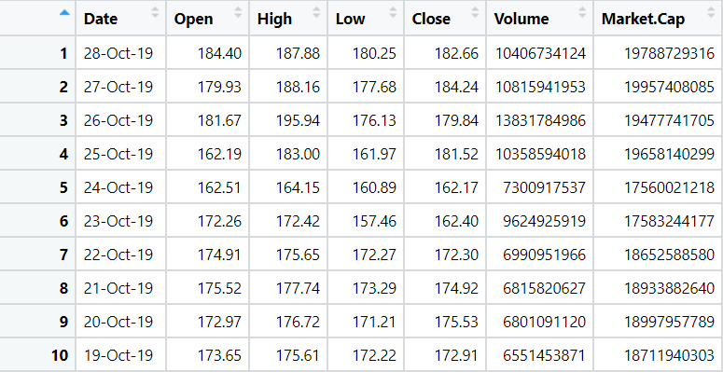
About Dataset
Dataset contain Ethereum price from 2015 t0 2019
It has 7 fields
Open-First traded price on each trading day
High-Highest price a potential buyer is willing to pay for a cryptocurrency
Low-Lowest price a potential buyer is willing to pay for a cryptocurrency
Close-Last transacted price
Volume- How many times a coin changes hands over a given time frame
Market.Cap- market value of a cryptocurrency.

Slide 4
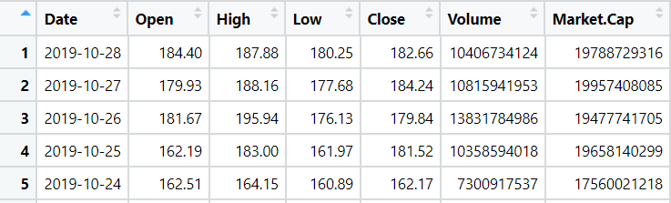
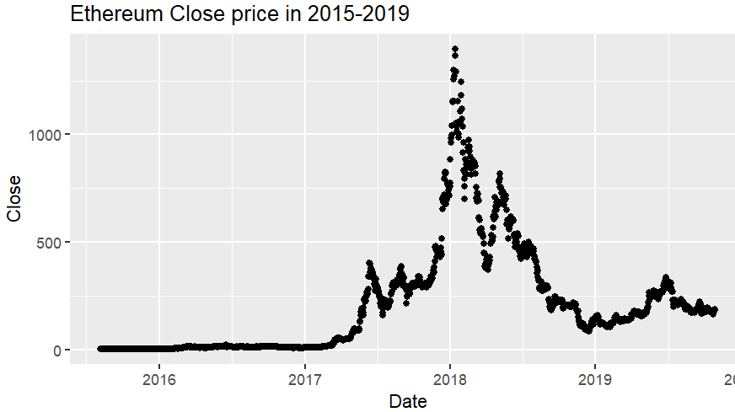
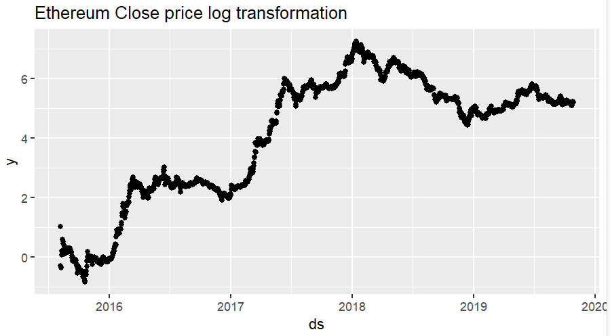
Data Preprocessing
Date conversion
Data is skewed log function is used.
Check for Time series
Stationary or non stationary
Using Augmented Dicky Fuller Test
From the test it is non stationary

Slide 5
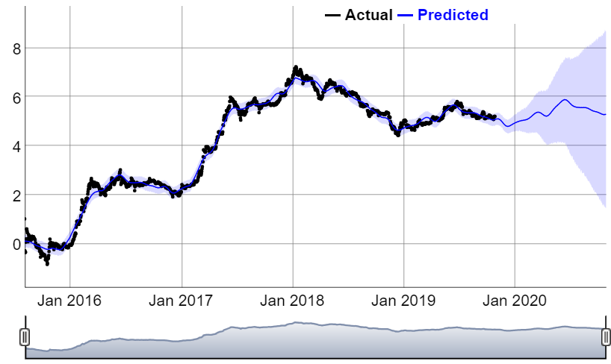
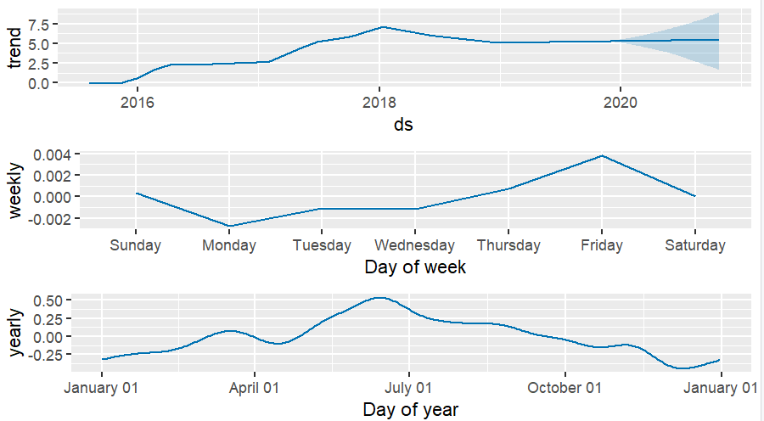
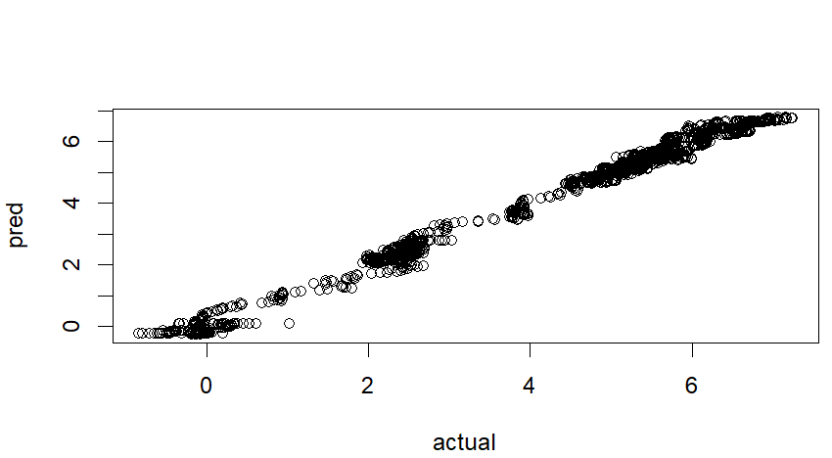
Prophet Model
Prophet is a procedure for forecasting time series data Using Prophet package
Predict Ethereum price of next 365 days

Slide 6
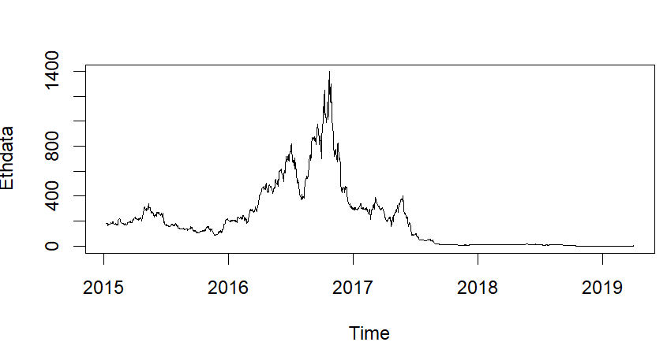
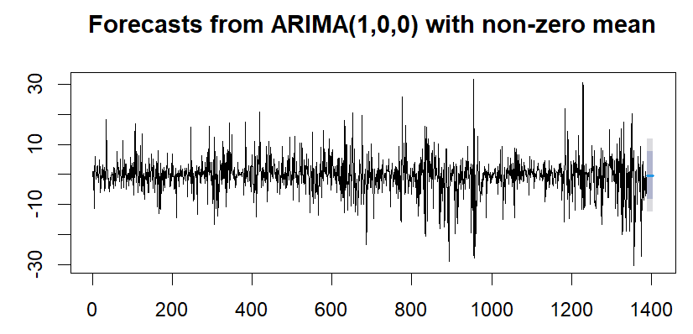
Arima Model
The ARIMA model (an acronym for Auto-Regressive Integrated Moving Average), essentially creates a linear equation which describes and forecasts your time series data.
Using forecast library
Arima model predict the value based on single variable

Slide 7

Model Evaluation
Mean Square Error of Prophet Model : 0.0379303
Root Mean Square Error of Prophet Model:0.194757
Mean Square Error of Arima Model :0.1958994
Root Mean Square Error of Arima Model:8.725413
From two model the least mean square error is for Prophet model.
So for Ethereum Price Prediction Prophet Model is the best model

Slide 8



